Slide 1
為您帶來生物、生態及環境科學的一流研究
BioOne 生物生命科學期刊資料庫
操作使用手冊

Slide 2
About BioOne

Slide 3
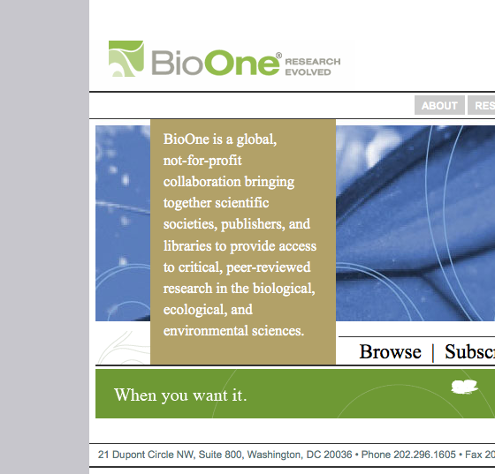
BioOne is…
About BioOne
An innovative, not-for-profit library-publisher partnership created to provide sustainable, cost-effective access to critical scientific research 非營利的圖書館出版商創新合作，提供重要的科學研究有持續性的、具成本效益的資源管道
A full-text database of current, peer-reviewed journals with access provided by your library現刊內容經同儕審閱的全文期刊資料庫
Focused in the biological, ecological, and environmental sciences 聚焦生物、生態及環境科學
Notes:
BioOne is an innovative, not for profit library publisher partnership begun in 1999. We were created by our founders to provide sustainable cost-effective access to critical scientific research.
The result of this collaboration was and is a full-text database of current, peer-reviewed journals in the biological, ecological, and environmental sciences, that launched in 2001 and continues strong today.

Slide 4
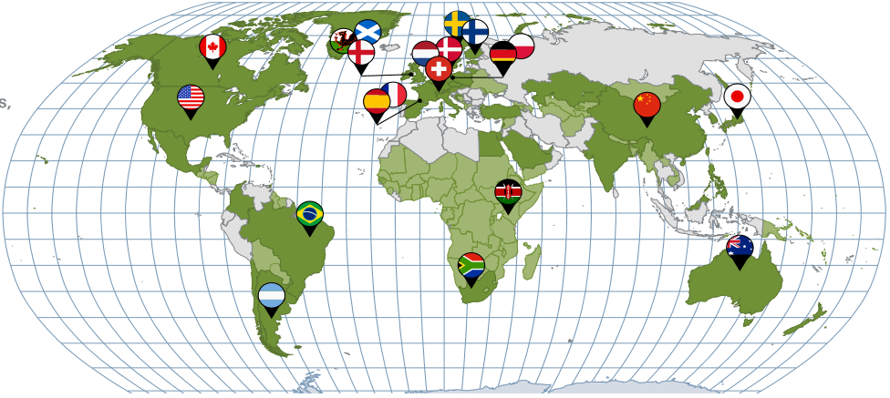
全球網路研究社群
About BioOne
Over 4,000 accessing institutions in 49 countries 超過4000個使用單位來自49個國家
200 journals from 149 nonprofit publishers in more than 17 countries 200種期刊來自17個國家的149個非營利出版商出版內容
Notes:
BioOne is a truly global network, reaching over 4,000 institutions across the world. 1,400 of these institutions are subscribers and over 3,000 receive free access through our participation in philanthropic programs that bring BioOne into the developing world.
It’s important that we provide this global audience with content from around the world. 17 countries are represented among our 135 nonprofit publishing partners including several in Asia, notably Japan and China. As you can see from the map the majority of our international publishers are concentrated in Europe, though we are pleased to to have a BioOne presence on six continents. We’re working on a presence in Antarctica ☺

Slide 5
創立BioOne的大學、學/協會包括：
About BioOne
美國生物科學研究所（AIBS）
學者出版及學術資源聯盟（SPARC）
美國肯薩斯大學（The University of Kansas）
美國西部圖書館聯盟（GWLA）
亞倫出版公司（Allen Press, Inc.）
Notes:
BioOne is a truly global network, reaching over 4,000 institutions across the world. 1,400 of these institutions are subscribers and over 3,000 receive free access through our participation in philanthropic programs that bring BioOne into the developing world.
It’s important that we provide this global audience with content from around the world. 17 countries are represented among our 135 nonprofit publishing partners including several in Asia, notably Japan and China. As you can see from the map the majority of our international publishers are concentrated in Europe, though we are pleased to to have a BioOne presence on six continents. We’re working on a presence in Antarctica ☺

Slide 6
BioOne Complete Scope & Content
Notes:
Next, I will talk about BioOne’s content coverage and community of publishing partners.

Slide 7
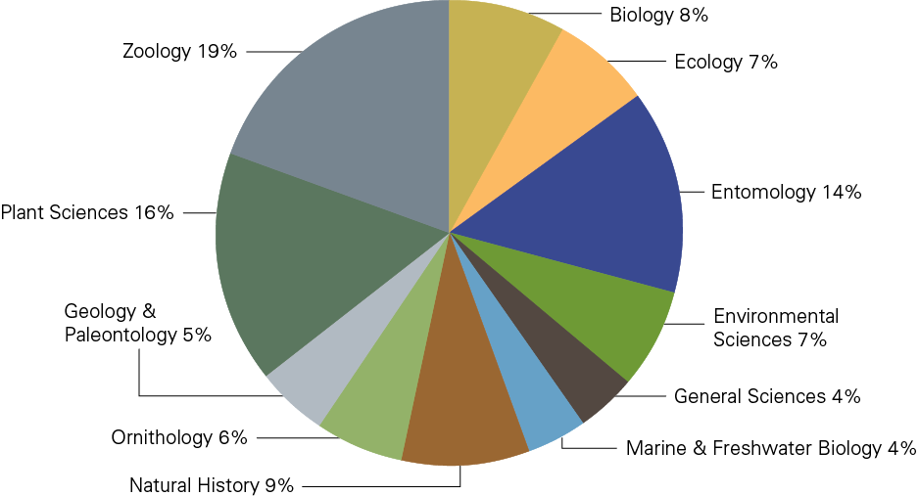
BioOne Complete at a Glance
BioOne Collections
200 titles from 149 society and nonprofit publishers 200種期刊來自17個國家的149個非營利出版商出版內容
More than 150,400 articles and1.2 million pages with new articles added daily
現刊內容每日更新，內容超過150,400篇文章和120萬頁
Notes:
In 2014, the BioOne aggregation will include 179 titles from 135 independent societies, associations, museums, research institutes, and presses around the world. The database includes more than 115,000 articles and more than 1,000,000 pages, with new content added on a daily basis.
Much of BioOne’s content is interdisciplinary in nature, making the collection a ‘must have’ for any general science program. However, BioOne also offers an impressive content concentration in many of our core fields, including zoology, biology, ecology, plant sciences, geology & paleontology, environmental sciences, ornithology, marine & freshwater biology, and natural history.

Slide 8
BioOne Complete at a Glance
BioOne Collections
農業
乳製品與畜牧學
農業經濟學
生物學
生物化學
生物物理學
分子生物學
生物多樣性保護
細胞生物學
發育生物學
生態學
工程學
環境科學
昆蟲學
進化生物學
基因、遺傳學
水產學
林學
地理學
地學
湖沼學
海洋與淡水生物學
微生物學
鳥類學
古生物學
寄生蟲學
植物學
公共環境與職業衛生學
運動科學
獸醫學
動物學
Notes:
BioOne is proud to feature thirteen open access publications as part of our Open Access Collection. These titles are fully integrated with the subscribed collection, and are freely available to all users, worldwide.

Slide 9
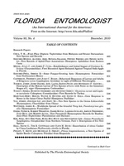
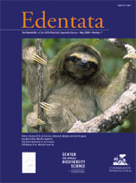
BioOne Complete at a Glance
BioOne Collections
19 Open Access publications from 17 nonprofit publishers 收錄出版於17間非營利出版商的19種開放近用出版品
Notes:
BioOne is proud to feature thirteen open access publications as part of our Open Access Collection. These titles are fully integrated with the subscribed collection, and are freely available to all users, worldwide.

Slide 10
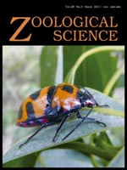
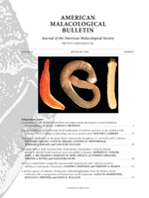
BioOne Complete at a Glance
BioOne Collections
Just under 50% of titles exclusively available online through BioOne, 73% of current titles are available in full text XML exclusive to BioOne
50%以上期刊獨家提供，佔全文文章73%
Notes:
One of the main criticisms of aggregations is that they are duplicative, with all content available elsewhere. This is not the case with BioOne. 62 of our titles – more than a third of our total – are available online exclusively through BioOne.

Slide 11
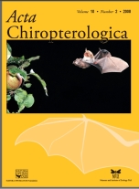
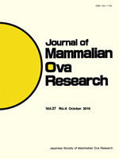
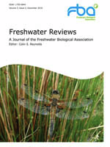
BioOne Complete at a Glance
BioOne Collections
24% of titles based outside the US 美國境外期刊出版的文章達24%
Notes:
Titles’ international scope and appeal are very important to BioOne and our users. Though BioOne is based in the United States, we are proud to feature 41 titles based outside of the US.
Brazil
Canada
China
Denmark
Finland
France
Japan
Kenya
Netherlands
Poland
South Africa
Sweden
United Kingdom
Countries Represented

Slide 12
BioOne Complete at a Glance
BioOne Collections
77% ISI-ranked subscribed titles in many of BioOne core fields, including: BioOne有77%的期刊是由ISI收錄並排名，包括：
Biodiversity Conservation – 10 BioOne titles out of 40 total ranked (25%)
Ecology – 24 BioOne titles out of 136 total ranked (18%)
Entomology - 21 BioOne titles out of 87 total ranked (24%)
Ornithology – 10 BioOne titles out of 22 total ranked (46%)
Paleontology – 11 BioOne titles out of 50 total ranked (22%)
Plant Sciences – 24 BioOne titles out of 195 total ranked (12%)
Zoology – 26 BioOne titles out of 149 total ranked (18%)
Notes:
Ranking by Thomson Reuters’ Institute of Scientific Information is an important metric to many of our subscribers. We are proud to report that nearly three quarters of our titles have an ISI Impact Factor.
As you can see from this list, these rankings also support BioOne’s dominance in a number of core fields. For example, BioOne features nearly half of all ranked titles in Ornithology, and a quarter of all ranked titles in Biodiversity Conservation.
You may also be interested to know that the average cited half life for BioOne-ranked titles is over seven years. This is an excellent indication of just how long the research in BioOne’s titles is used and cited. This is also supported by the fact that BioOne’s archival content is used nearly as much as current content by our users.

Slide 13
Collection Development 收錄演變
BioOne Collections
Inclusion in BioOne Complete is by invitation-only. We look for titles that are: BioOne收錄受邀文章，限於：
Highly cited and/or ranked by ISI 高度引用 且/或 有ISI排名
International in scope and appeal 國際範圍和吸引力
Previously unavailable online or with limited functionality 線上無法取得或功能受限
Well-regarded by our community of users 備受BioOne使用者關注的
3-8 New titles added ever year. 每年增加3~8種期刊
Notes:
One of the frequent questions that we are asked is how we decide which titles to add to the BioOne collections. While we are lucky to receive hundreds of inquiries each year from titles around the world, inclusion in BioOne is by invitation-only, and the process quite competitive.
We typically only add a few new titles each year, in order to keep costs down for subscribers. We seek additions that are highly cited and have strong usage histories. Titles must also be international in scope, and complement existing titles in the collection. We also prioritize titles that are only available in print, and do not yet have an online presence. Lastly, we rely heavily on feedback from our community on which titles they would like to see added to the collection.
I am pleased to announce that three titles joined the collection in January: Arachnology, from the British Arachnological Society, Ardeola, from the Spanish Society of Ornithology, and Herzogia, from the Bryological and Lichenological Association for Central Europe.

Slide 14
Demonstration 操作說明

Slide 15
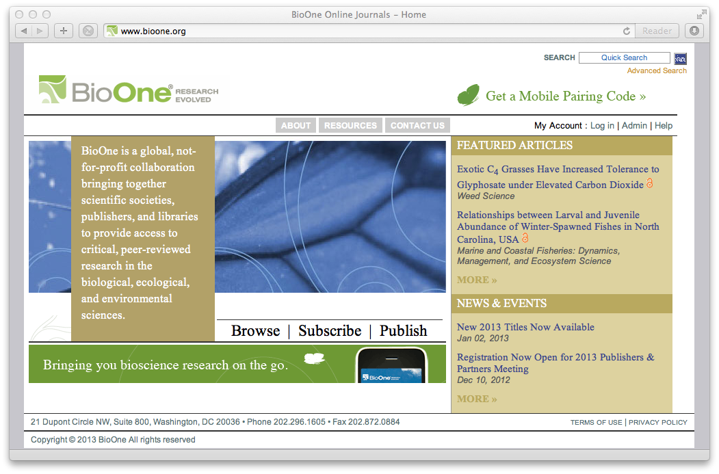
首頁重點介紹
快速檢索與高級檢索
個人帳號登入
焦點文章
分類瀏覽
Notes:
On every page of the site:
Searching
Quick Search box to enter keywords
Link to Advanced Search to construct a tailored search
Tool navigation
Help section with info on using BioOne features and tools
Log in or Register to customize and manage your research on BioOne
Browse Titles
Browse an A to Z listing of all BioOne publications and link directly to titles’ Current Issue, List of Issues, or Title Information
Homepage Featured Articles
Participating publishers select articles to feature on the BioOne site

Slide 16
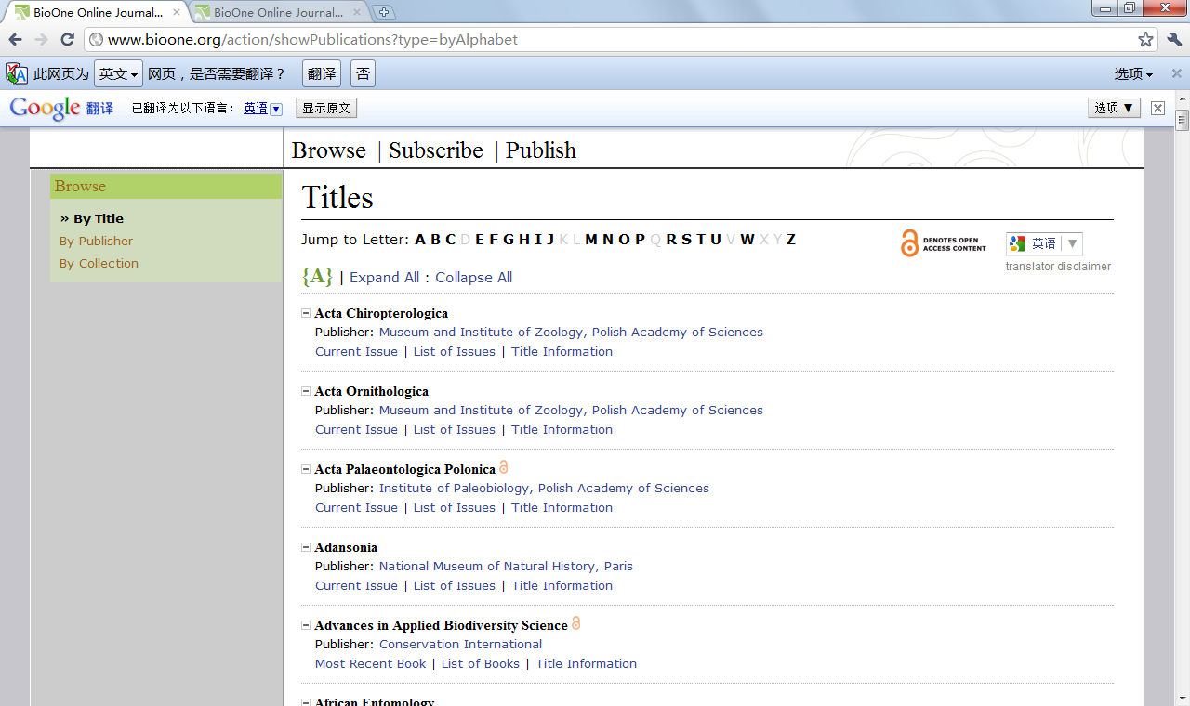
瀏覽功能
刊名瀏覽
翻譯工具
可瀏覽現刊與過刊
Notes:
If asked what the blue image is or represents, say you don’t know and blame Susi and Lauren. Or say that it’s a visual demonstration of reader-response theory: it is in fact whatever the viewer brings to it. Or say, as the friend of one of our BOD members commented, that it must be a cropped shot of a girl in a pleated denim skirt.
16

Slide 17
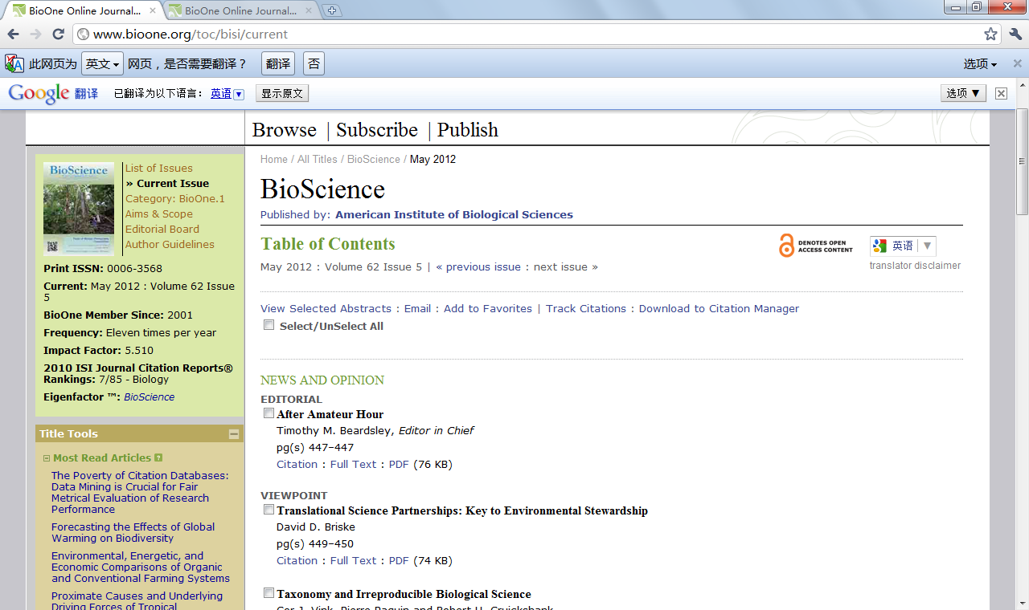
期刊瀏覽
期刊基本訊息
IF及JCR排名
可瀏覽HTML、PDF全文格式
Notes:
If asked what the blue image is or represents, say you don’t know and blame Susi and Lauren. Or say that it’s a visual demonstration of reader-response theory: it is in fact whatever the viewer brings to it. Or say, as the friend of one of our BOD members commented, that it must be a cropped shot of a girl in a pleated denim skirt.
17

Slide 18
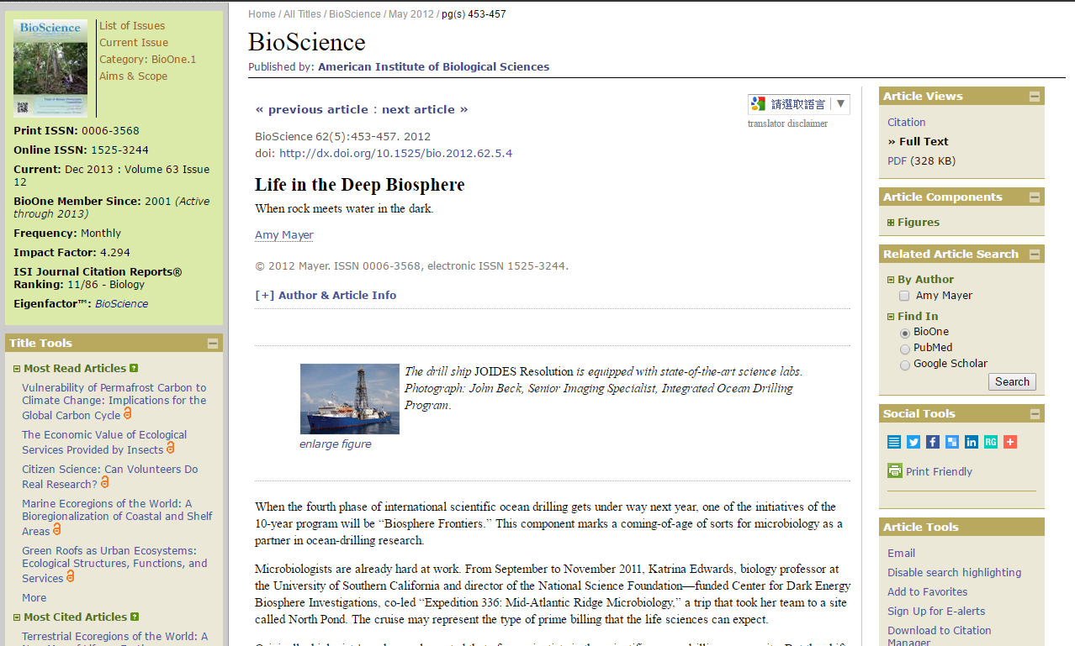
期刊瀏覽-HTML格式
點擊瀏覽圖片文件
Notes:
If asked what the blue image is or represents, say you don’t know and blame Susi and Lauren. Or say that it’s a visual demonstration of reader-response theory: it is in fact whatever the viewer brings to it. Or say, as the friend of one of our BOD members commented, that it must be a cropped shot of a girl in a pleated denim skirt.
18

Slide 19
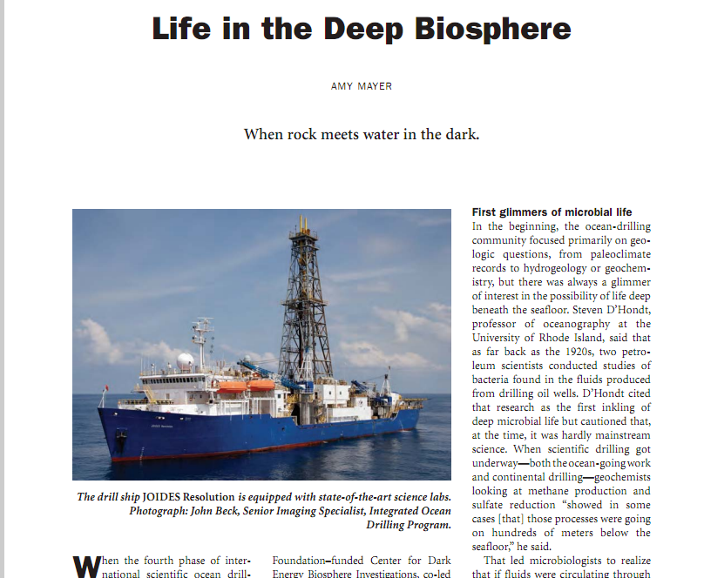
期刊瀏覽-PDF格式
Notes:
If asked what the blue image is or represents, say you don’t know and blame Susi and Lauren. Or say that it’s a visual demonstration of reader-response theory: it is in fact whatever the viewer brings to it. Or say, as the friend of one of our BOD members commented, that it must be a cropped shot of a girl in a pleated denim skirt.
19

Slide 20
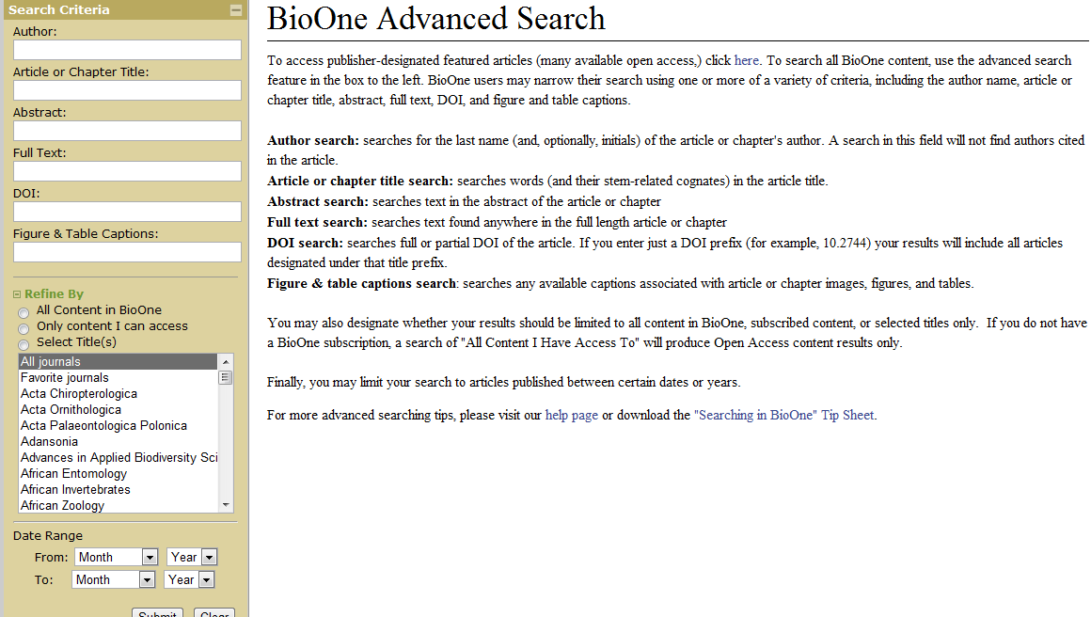
BioOne-高級檢索
依需求在限定欄位鍵入關鍵詞
限定搜索內容及時間範圍
Notes:
If asked what the blue image is or represents, say you don’t know and blame Susi and Lauren. Or say that it’s a visual demonstration of reader-response theory: it is in fact whatever the viewer brings to it. Or say, as the friend of one of our BOD members commented, that it must be a cropped shot of a girl in a pleated denim skirt.
20

Slide 21
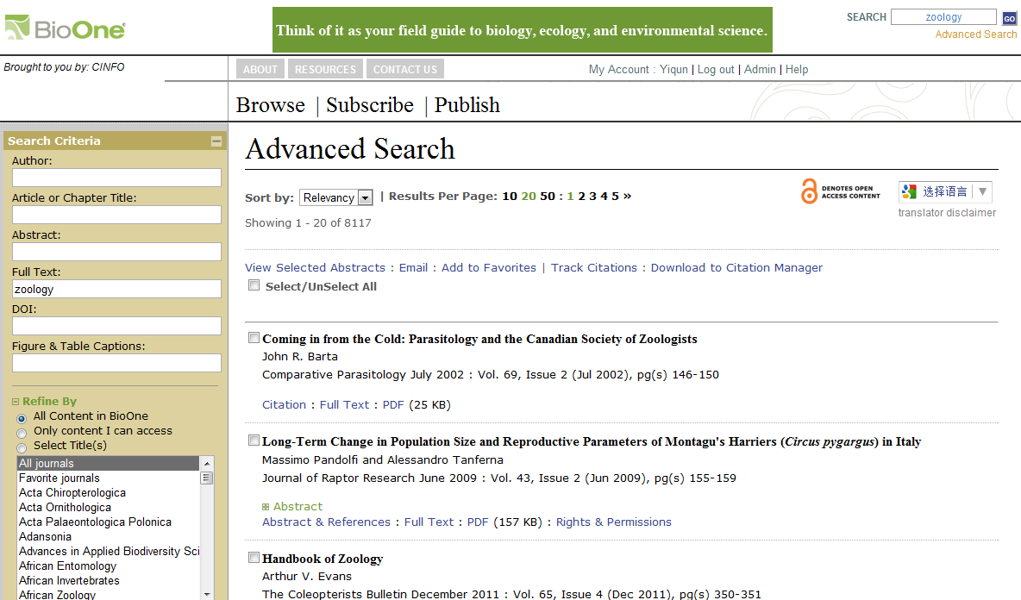
BioOne-檢索結果
依相關度或時間排序
勾選項目加到我的最愛及引文管理
點選文章摘要、參考文獻或看全文
Notes:
If asked what the blue image is or represents, say you don’t know and blame Susi and Lauren. Or say that it’s a visual demonstration of reader-response theory: it is in fact whatever the viewer brings to it. Or say, as the friend of one of our BOD members commented, that it must be a cropped shot of a girl in a pleated denim skirt.
21

Slide 22
文章檢視-HTML格式
點擊瀏覽圖片文件
社群工具及其他附加功能
Notes:
If asked what the blue image is or represents, say you don’t know and blame Susi and Lauren. Or say that it’s a visual demonstration of reader-response theory: it is in fact whatever the viewer brings to it. Or say, as the friend of one of our BOD members commented, that it must be a cropped shot of a girl in a pleated denim skirt.
22

Slide 23
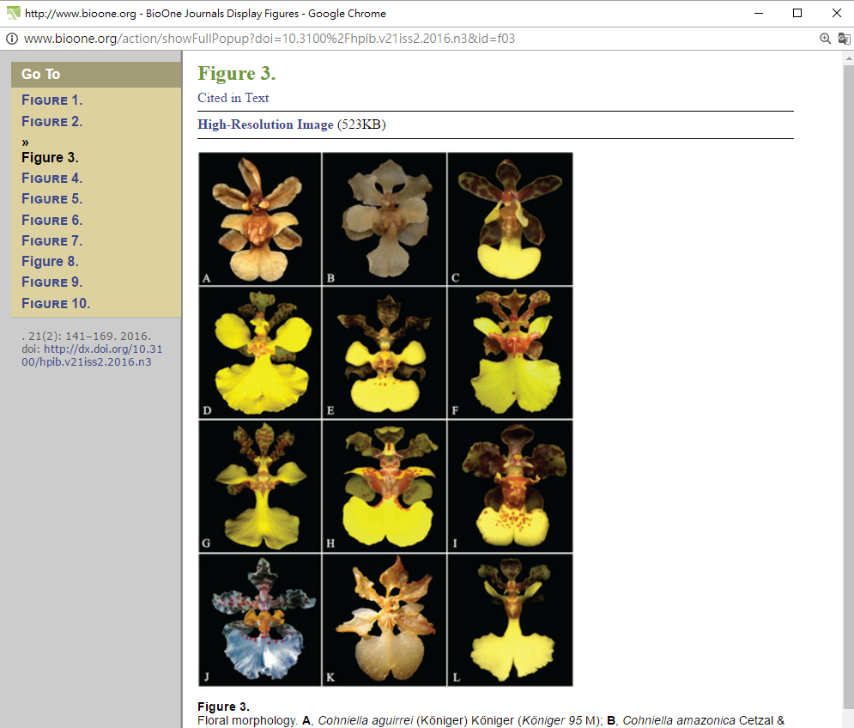
圖片檢視
Ctrl+滑鼠或縮放比例設定檢視圖片
Notes:
If asked what the blue image is or represents, say you don’t know and blame Susi and Lauren. Or say that it’s a visual demonstration of reader-response theory: it is in fact whatever the viewer brings to it. Or say, as the friend of one of our BOD members commented, that it must be a cropped shot of a girl in a pleated denim skirt.
23

Slide 24
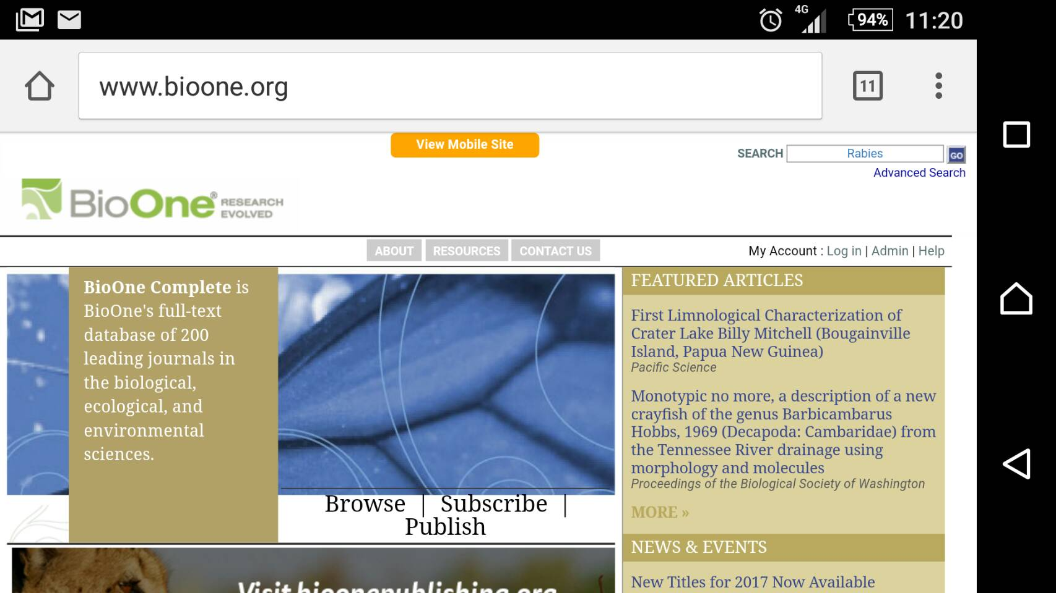
BioOne Mobile 手機版
手機版功能自動顯示
Notes:
If asked what the blue image is or represents, say you don’t know and blame Susi and Lauren. Or say that it’s a visual demonstration of reader-response theory: it is in fact whatever the viewer brings to it. Or say, as the friend of one of our BOD members commented, that it must be a cropped shot of a girl in a pleated denim skirt.
24

Slide 25
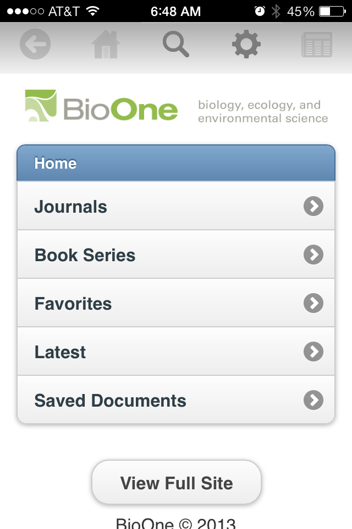
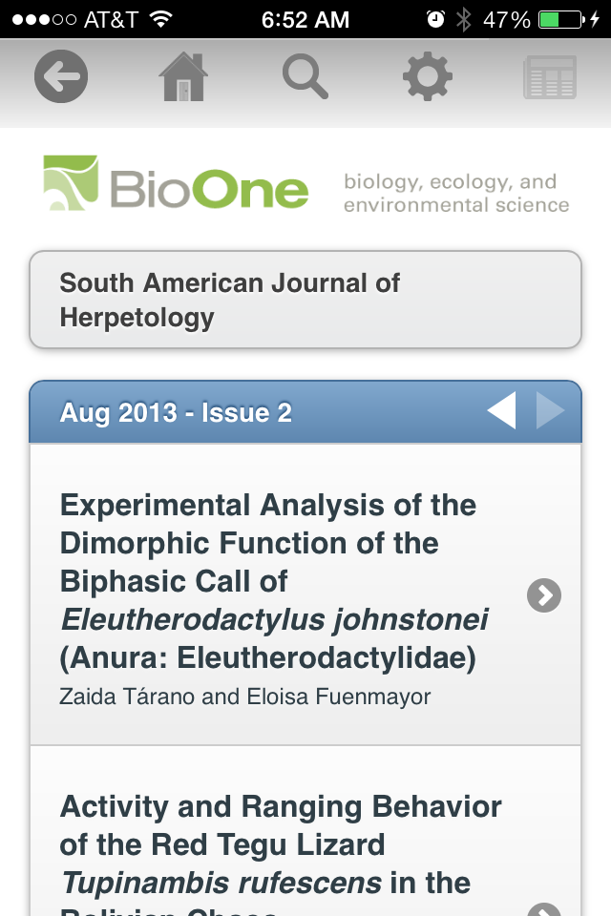
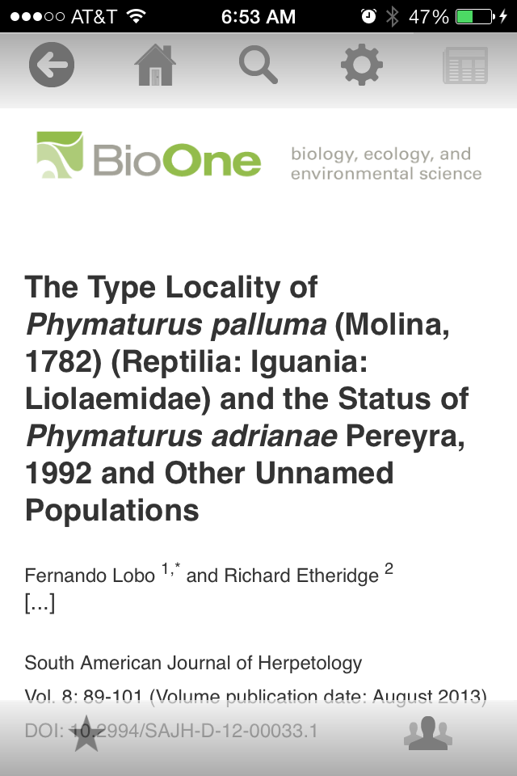
BioOne Mobile手機版
Notes:
If asked what the blue image is or represents, say you don’t know and blame Susi and Lauren. Or say that it’s a visual demonstration of reader-response theory: it is in fact whatever the viewer brings to it. Or say, as the friend of one of our BOD members commented, that it must be a cropped shot of a girl in a pleated denim skirt.
25

Slide 26
Tools for Researching
研究者相關工具

Slide 27
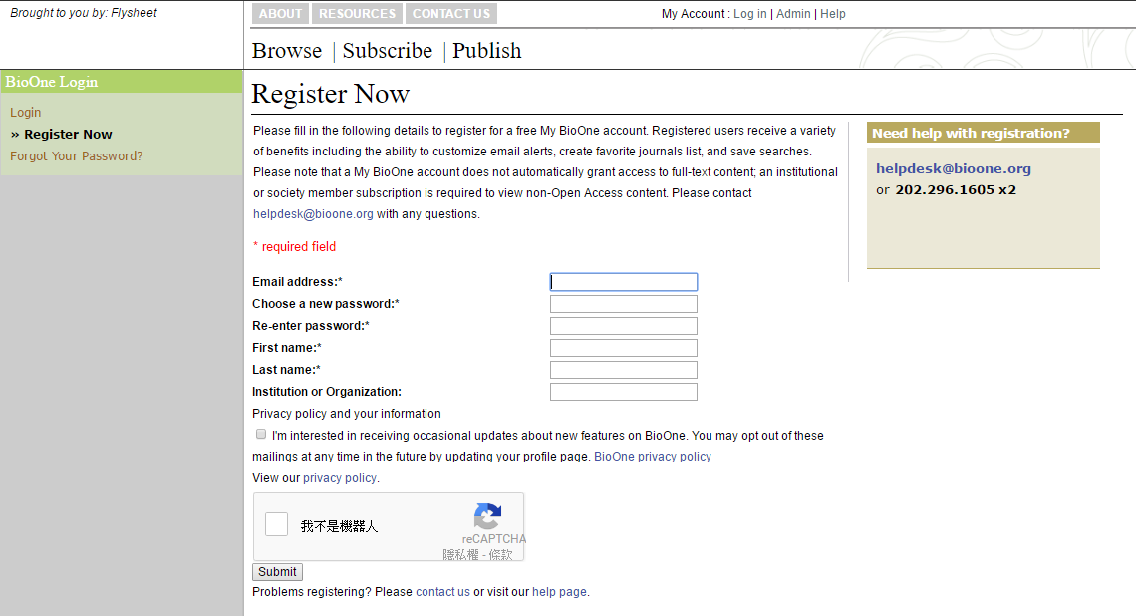
設定個人帳號
在校園授權IP範圍
點入Log in
註冊個人帳號
個人帳號優點
保存搜索歷史
引用及目錄通告
最愛期刊及文章設定
Notes:
If asked what the blue image is or represents, say you don’t know and blame Susi and Lauren. Or say that it’s a visual demonstration of reader-response theory: it is in fact whatever the viewer brings to it. Or say, as the friend of one of our BOD members commented, that it must be a cropped shot of a girl in a pleated denim skirt.
27

Slide 28
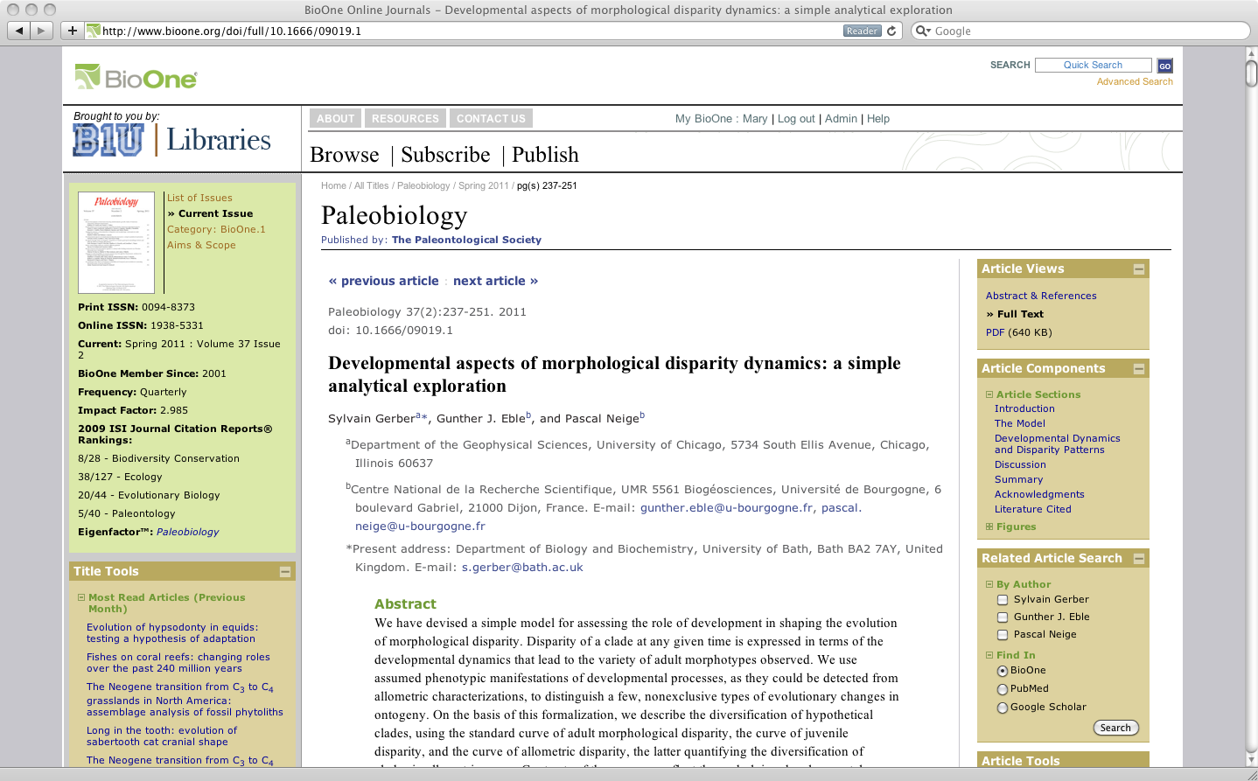
Article & Title Tools 文章工具
文章瀏覽
文章檢視-PDF格式
文章組成
相關文章搜索捷徑
最多人閱讀及最多人引用文章
文章匯出及應用工具
Notes:
If asked what the blue image is or represents, say you don’t know and blame Susi and Lauren. Or say that it’s a visual demonstration of reader-response theory: it is in fact whatever the viewer brings to it. Or say, as the friend of one of our BOD members commented, that it must be a cropped shot of a girl in a pleated denim skirt.
28

Slide 29
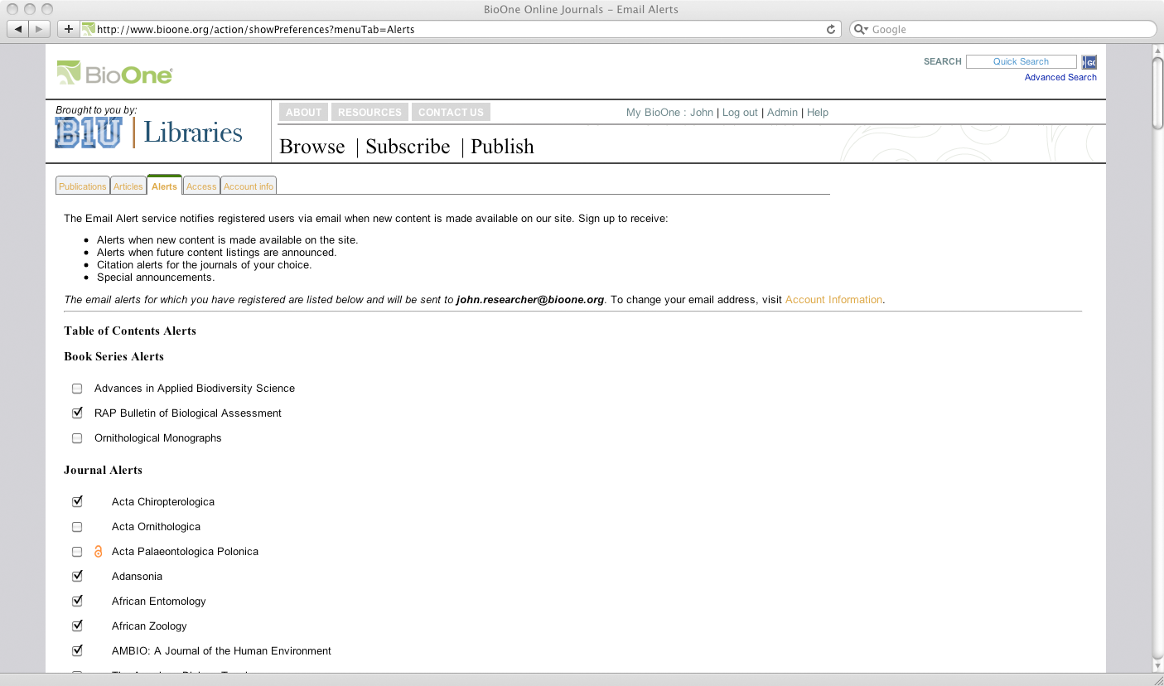
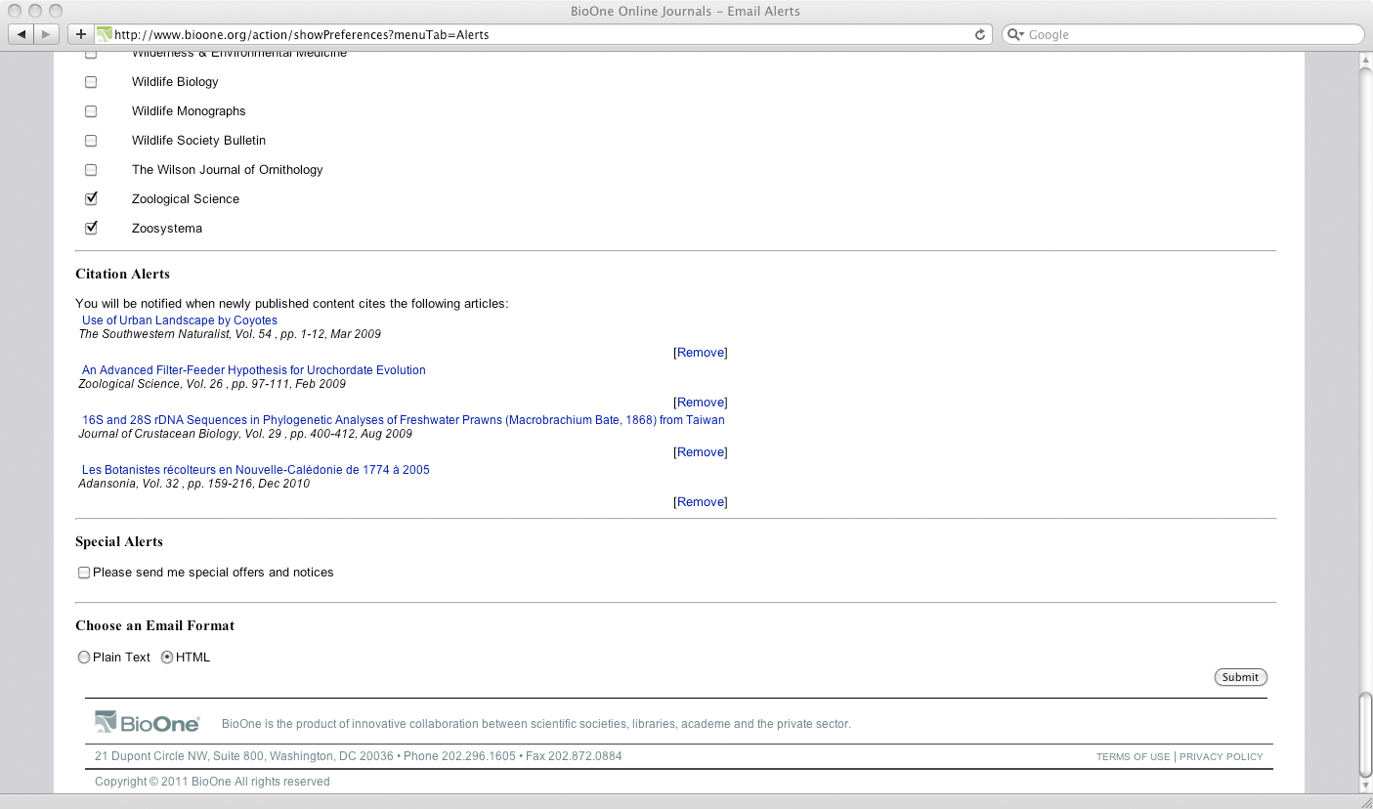
客製化通知-引用通告、目錄通告
在文章工具點選
Sign Up for E-alerts
Notes:
If asked what the blue image is or represents, say you don’t know and blame Susi and Lauren. Or say that it’s a visual demonstration of reader-response theory: it is in fact whatever the viewer brings to it. Or say, as the friend of one of our BOD members commented, that it must be a cropped shot of a girl in a pleated denim skirt.
29

Slide 30
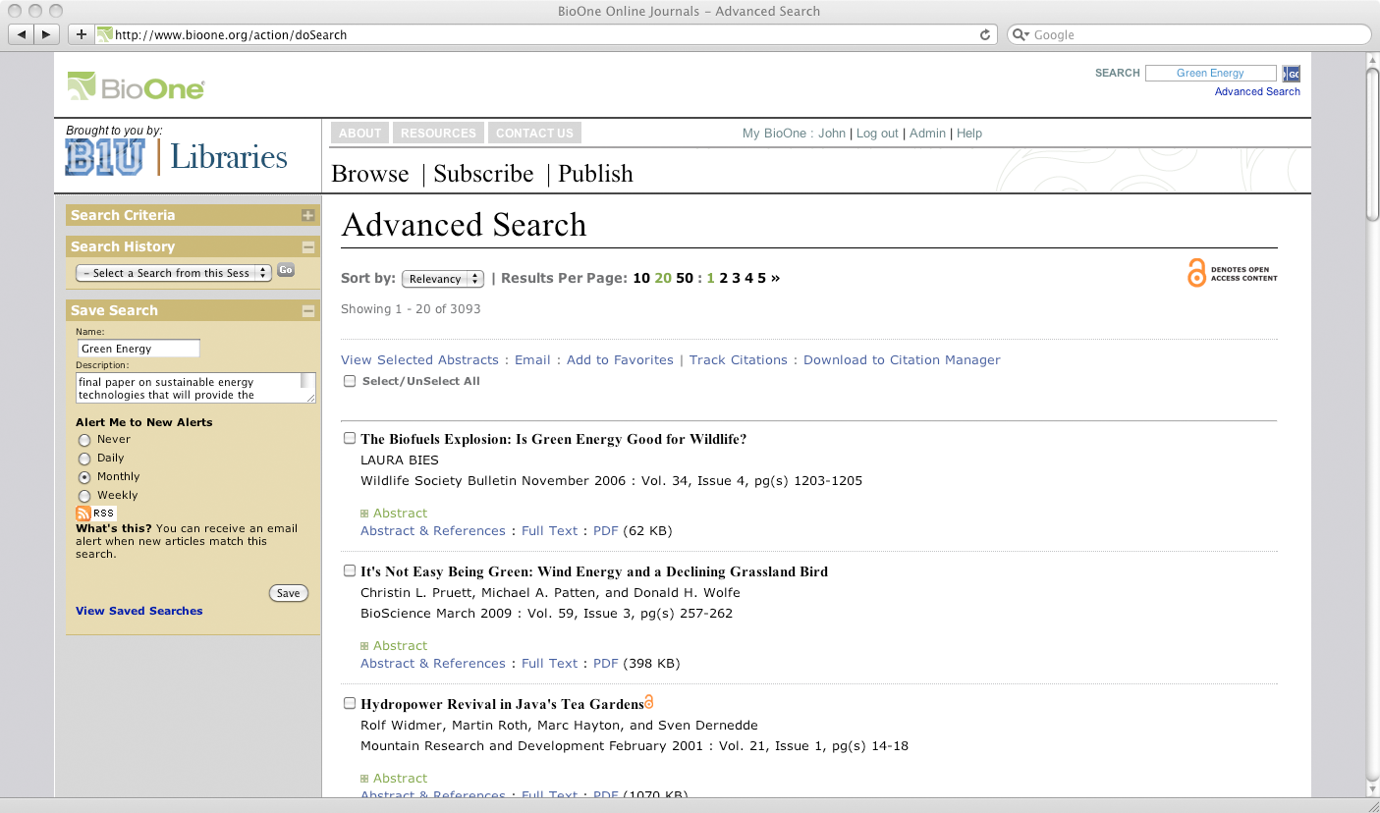
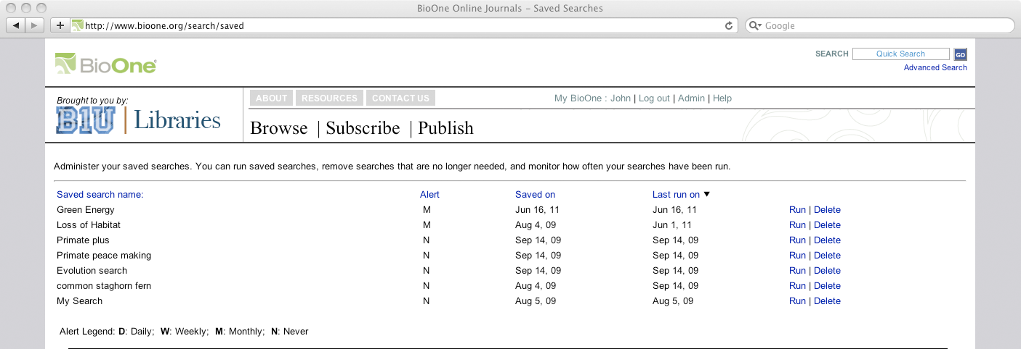
Saved Searches 儲存檢索
在搜索結果設定保存搜索歷史及關鍵字通告
Notes:
If asked what the blue image is or represents, say you don’t know and blame Susi and Lauren. Or say that it’s a visual demonstration of reader-response theory: it is in fact whatever the viewer brings to it. Or say, as the friend of one of our BOD members commented, that it must be a cropped shot of a girl in a pleated denim skirt.
30

Slide 31
Thank you!

